Slide 1

Heart Watch: A Data-Driven Approach to Heart Failure Prevention
Shanthibooshan Subramanian
Notes:
To replace this picture, just select and delete it. Then use the Insert Picture icon to replace it with one of your own!

Slide 2
Introduction
Global cardiovascular diseases claim 17 million lives annually.
Heart failure (HF) is a significant concern, characterized by the heart's struggle to pump enough blood.
The Heart Watch project leverages electronic medical records for precise analysis through biostatistics and machine learning.
Aim: Predict patient survival, especially given the prevalence of heart disease in the United States.

Slide 3
Problem Statement
Despite medical advancements, predicting and preventing heart failure remains challenging.
Lack of personalized insights for early intervention.
Critical gap: Absence of robust predictive models for analyzing extensive datasets.
Heart Watch goal: Pioneer advanced models for early detection and personalized interventions, potentially saving lives globally.

Slide 4
Dataset
Source: Centers for Disease Control and Prevention (CDC) via Kaggle
Dataset Size: 319,795 rows, 18 columns
Target Variable: "Heart Disease" (Coronary Heart Disease or Myocardial Infarction)

Slide 5
Feature Overview
Categorical Features | Continuous Features
Heart Disease Smoking Alcohol Drinking Stroke Difficulty Walking Sex Race Diabetic Physical Activity General Health Asthma Kidney Disease Skin Cancer | BMI (Body Mass Index) Physical Health Mental Health Age Category Sleep Time

Slide 6
Data Cleaning
Binary Categorical Variables Encoding
Multiclass Categorical Variables Handling
Balancing the Dataset
Scaling Continuous Features
Integer Encoding for Binary Variables

Slide 7
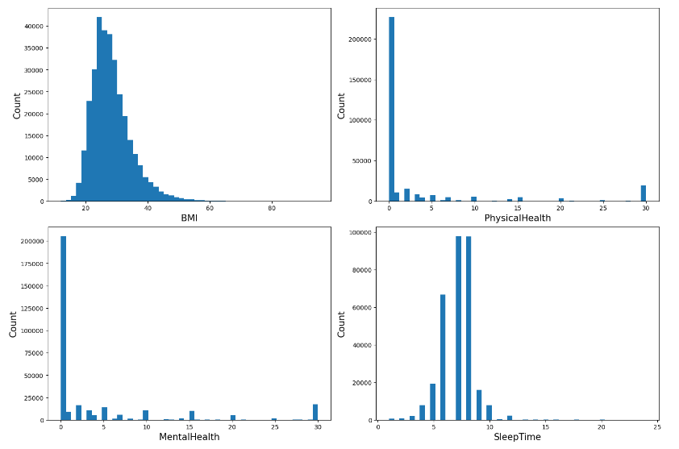
Visualization – Health Distribution by Age and Gender
Analyzing the data on physical and mental health distribution by age and gender provides valuable insights.

Slide 8
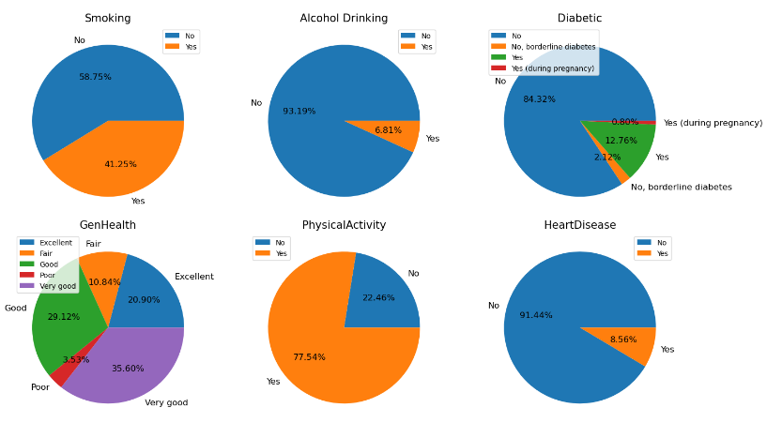
Visualization – Impact Data Analysis Heart Disease
Data shows that smoking, alcohol drinking, physical inactivity, and diabetes are all associated with an increased risk of heart disease

Slide 9
Strategic Model Selection
Logistic Regression
Random Forest
K-Fold Cross-Validation
Confusion Matrices

Slide 10
Key Performance Metrics
Accuracy
Precision
Recall
F1-Score
ROC AUC

Slide 11
Performance Metrics Evaluating Model Results
Model | Accuracy | Recall | Precision | F1
Logistic Regression(Class 0) | 76% | 75% | 77% | 76%
Logistic Regression(Class 1) | 76% | 78% | 76% | 77%
K fold Cross Validation (Class 0) | 76% | 74% | 77% | 76%
K fold Cross Validation (Class 1) | 76% | 78% | 77% | 76%
Random Forest(Class 0) | 97% | 93% | 1 | 96%
Random Forest(Class 1) | 97% | 1 | 93% | 96%

Slide 12
CONCLUSION
The "Heart Watch" project concludes with identifying the Random Forest Classifier as a standout model for heart failure prediction.
Remarkable accuracy, precision, and balanced performance position it as a compelling solution for early detection and intervention in heart disease cases.
While these results are promising, emphasizing further data analysis would enhance our findings' robustness.

Slide 13
Recommendations
Acknowledge the broader implications of accurate heart failure prediction models in revolutionizing patient care.
Emphasize the need for continued exploration and analysis of the data to refine and strengthen predictive models.
The success of the Random Forest Classifier suggests ongoing research to enhance the model's effectiveness in proactive heart failure prevention.

Slide 14
Model Ready for Deployment?
Highlight that the Random Forest Classifier demonstrates readiness for deployment in real-world healthcare settings.
Stress the importance of continuous monitoring and refinement based on real-world data and evolving medical insights.
Deployment holds the promise of enhancing public health and well-being through proactive prevention strategies, with a commitment to ongoing analysis and improvement.

Slide 15
REFERENCES
Heart Failure dataset, from Kaggle website: https://www.kaggle.com/datasets/fedesoriano/heart-failure-prediction
https://archive.ics.uci.edu/dataset/519/heart+failure+clinical+records
https://ieeexplore.ieee.org/document/10064888
https://www.ndc.scot.nhs.uk/docs/Heart%20Failure%20Dataset.pdf
https://www.sciencedirect.com/science/article/pii/S2001037016300460
https://bmcmedinformdecismak.biomedcentral.com/articles/10.1186/s12911-020-1023-5

Slide 16

Notes:
To replace this picture, just select and delete it. Then use the Insert Picture icon to replace it with one of your own!

Slide 17
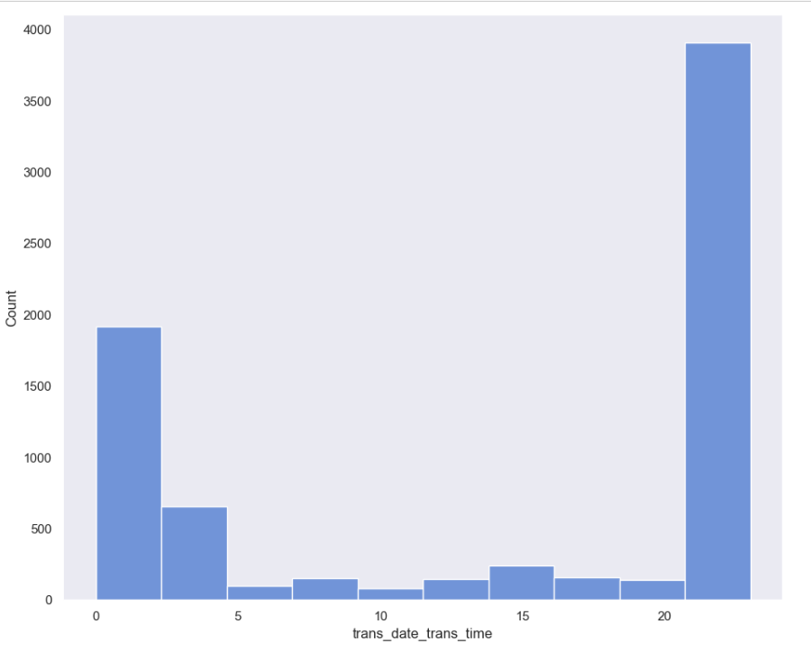
Histogram – Time Based Analysis Fraud Transactions
Hourly Analysis of Reported Credit Card Fraud Transactions: Identifying the Most Affected Hours Using Histograms

Slide 18
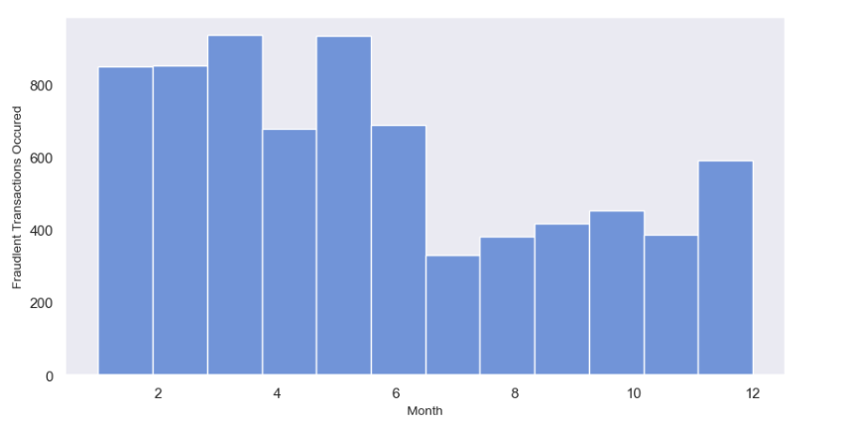
Histogram – Time Based Analysis Fraud Transactions
Monthly Analysis of Reported Credit Card Fraud Transactions: Identifying the Most Affected Monthly Using Histograms

Slide 19
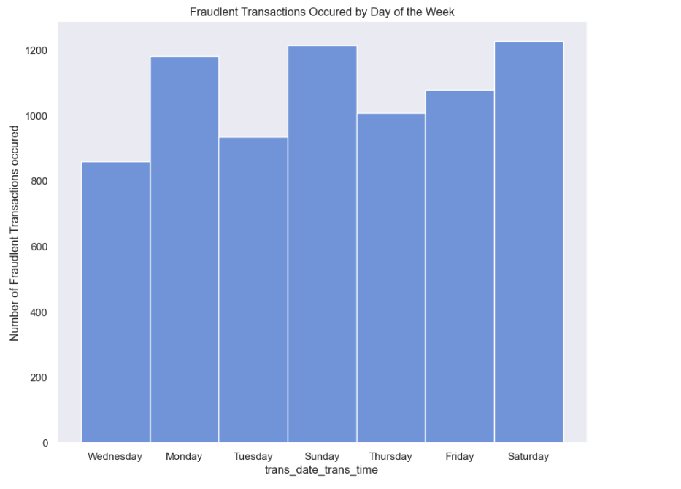
Histogram – Time Based Analysis Fraud Transactions
Day of Week Analysis of Reported Credit Card Fraud Transactions: Identifying the Most Affected Day of Week Using Histograms

Slide 20
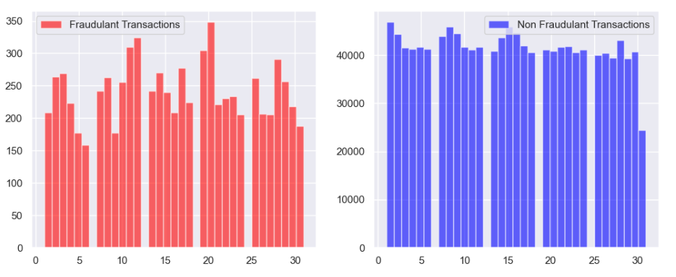
Histogram –Fraud Transactions Analysis
Fraudulent and Non-Fraudulent Transactions Analysis of Reported Credit Card Fraud Transactions: Identifying the count of Fraudulent and Non-Fraudulent Transactions.

Slide 21
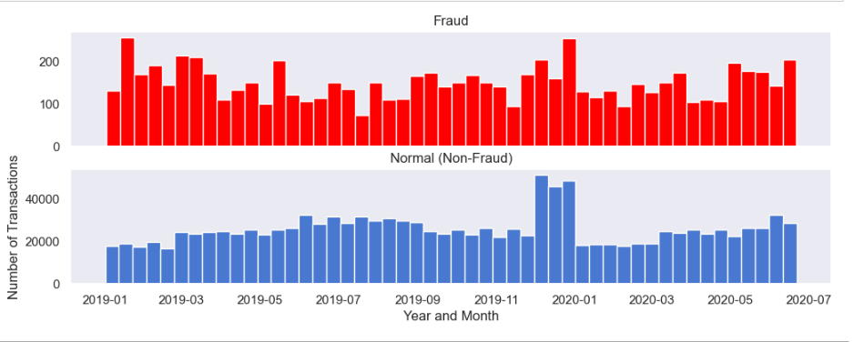
Histogram – Time Based Analysis of fraudulent and Non-Fraudulent Transactions
Fraudulent and Non-Fraudulent Transactions Analysis of Month and Year occurred fraudulent and Non-Fraudulent Transactions.

Slide 22
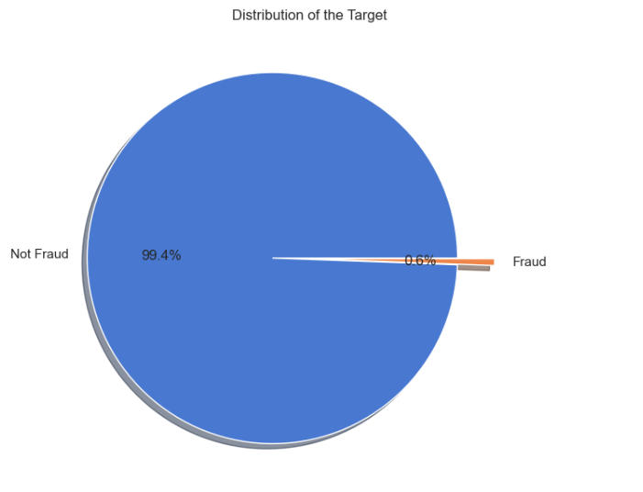
Pie Chart – Distribution of Target Variable
Fraudulent and Non-Fraudulent Transactions Analysis of Reported Credit Card Fraud Transactions: Identifying the count of Fraudulent and Non-Fraudulent Transactions.

Slide 23
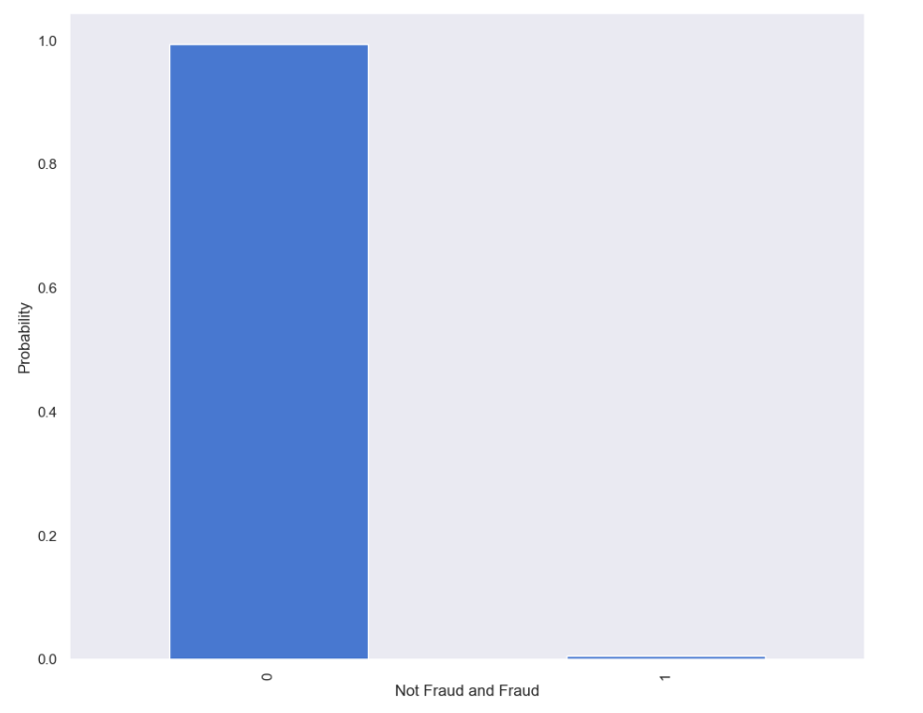
Probability Mass Function (PMF)
PMF function represents the two classes of Not fraud as 0 and fraud as 1 of the imbalanced nature of the dataset, as the proportion of non-fraudulent transactions is much higher than that of fraudulent transactions.

Slide 24
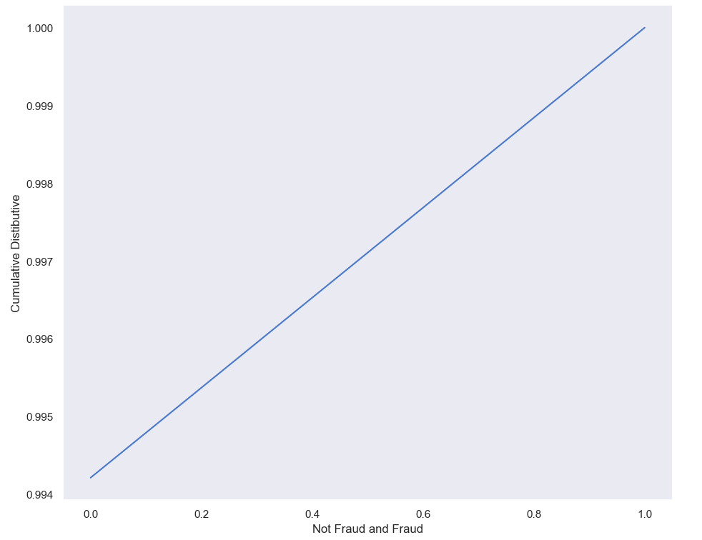
Cumulative Distributive Function (CDF)
CDF represents the two classes of Not fraud as 0 and fraud as 1 of the imbalanced nature of the dataset, as the proportion of non-fraudulent transactions is much higher than that of fraudulent transactions.

Slide 25
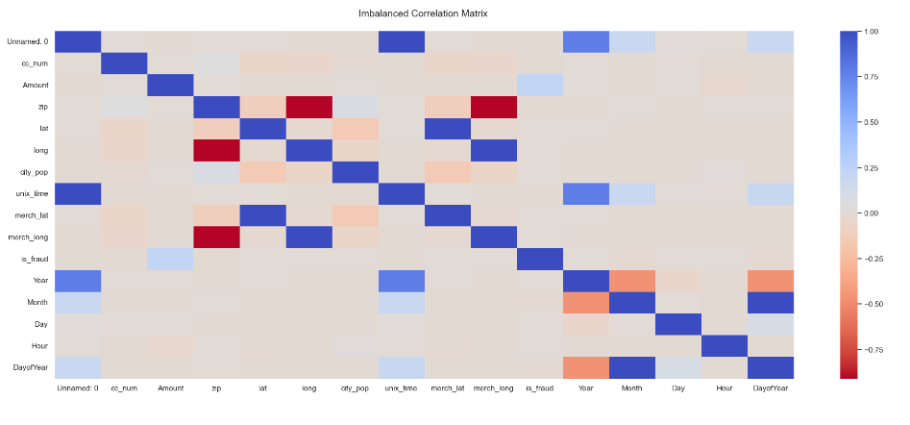
Imbalanced Correlation Matrix
Strength of the relationship between the variables. This is the correlation or heat map for all the features of my project ranging values from -1 to 1

Slide 26
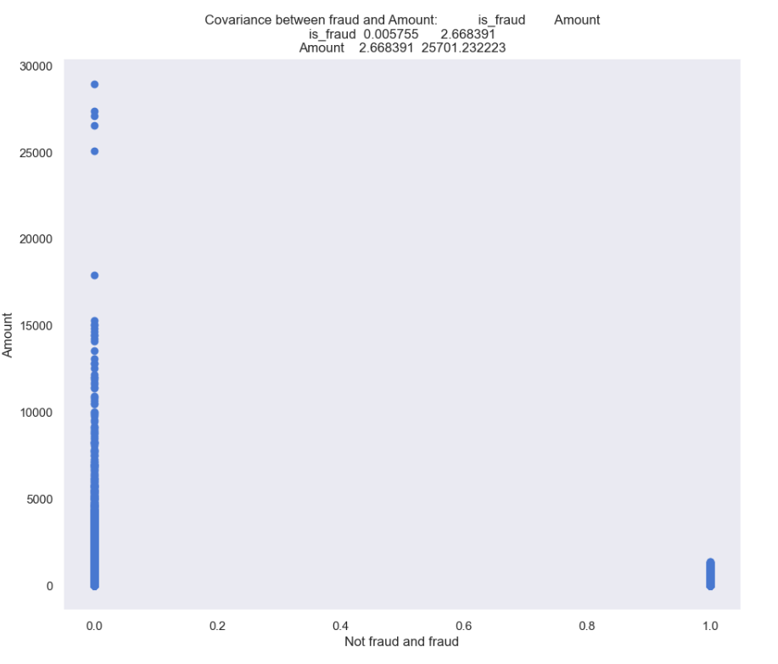
Covariance
Covariance between the two variables are is_fraud and Amount. Positive covariance indicates that the two features tend to increase or decrease together

Slide 27
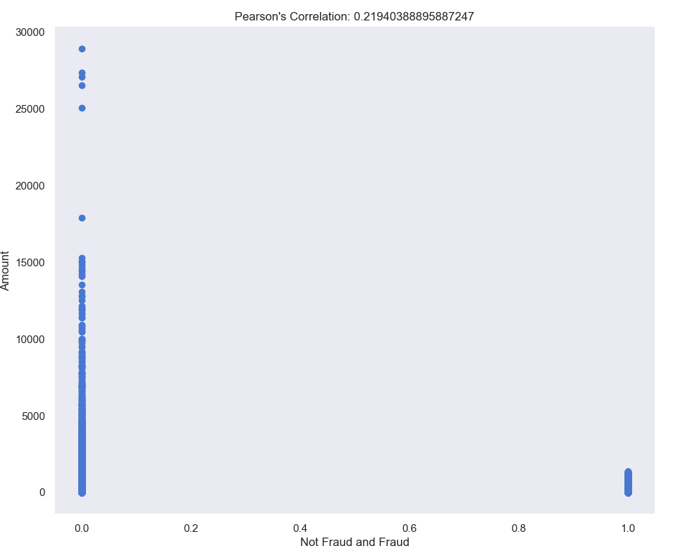
Person’s Correlation
Pearson correlation between the two variables is_fraud (fraud, not fraud) and Amount.

Slide 28
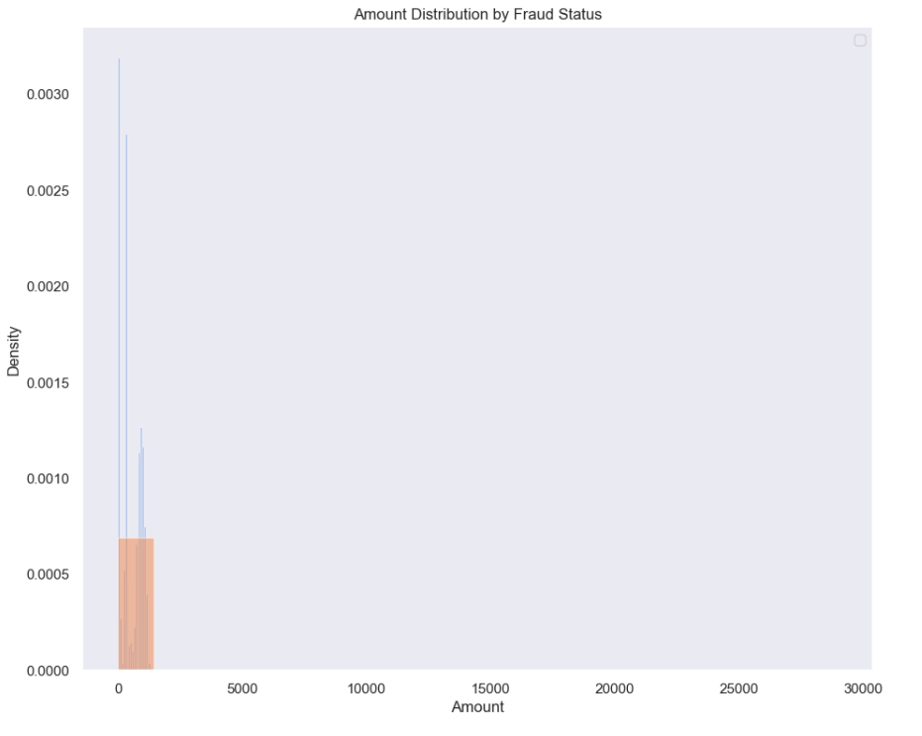
Normal Distribution
Pearson correlation between the two variables is_fraud (fraud, not fraud) and Amount.

Slide 29
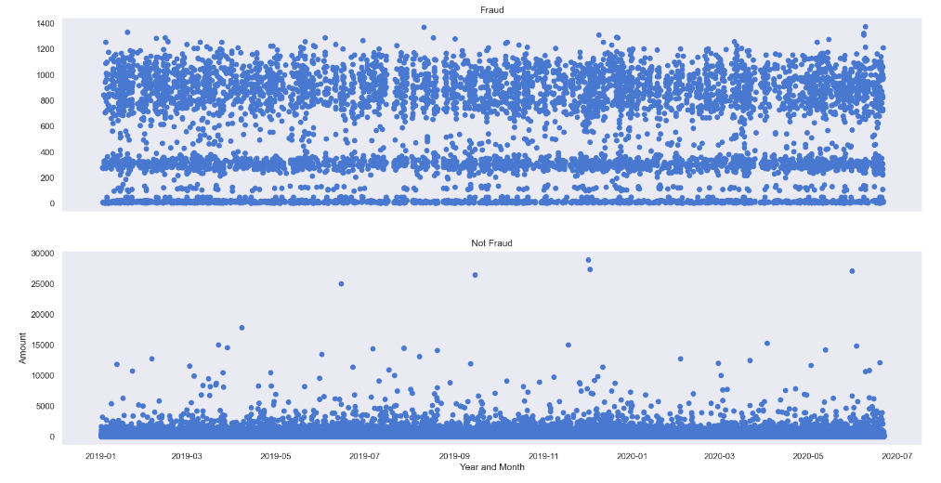
Scatter Plot
Scatter Plot visualizes the distribution of the data and any patterns or relationships between is_fraud (fraud, not fraud) and the Amount.

